Slide 1
STAT 5214G: Final Project Using MLR to assess and predict housing prices in suburban Richmond
Marshall Tuck

Slide 2
motivation
My wife and I decided to sell our house back in February, with the intent to downsize for my wife to stay at home with our new son. We sold in April.
Coronavirus hit, and the market froze up, so we’ve been living with her parents
Every single day, we spend time on Zillow and Trulia looking at houses, trying to not overpay.
On top of that, her mom is a realtor, so her mom is constantly looking at houses.
I wanted to know how we could identify ”good prices”, and what factors to look for?

Slide 3
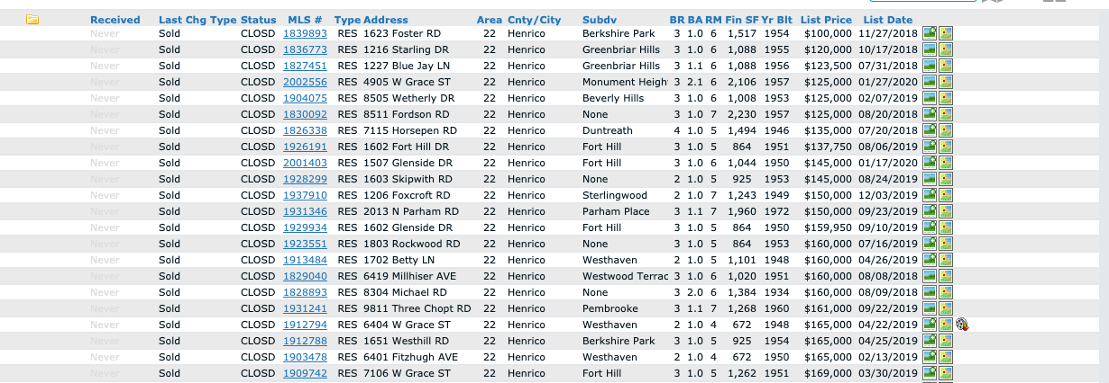
Data gathering and Wrangling
Variables of interest provided by MLS:
Bedrooms/Bathrooms/Rooms
Square Footage
Year Built
List Price
List Date
Year Built
Sales Price
Tax Assessed Value

Slide 4
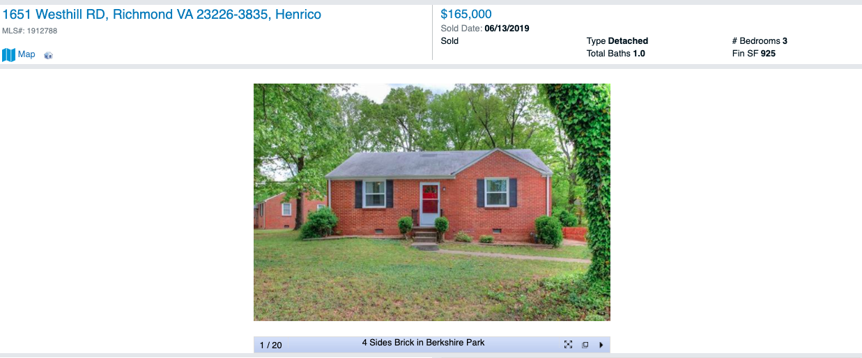
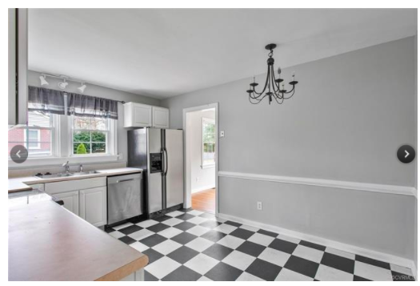
Data gathering and Wrangling
Variables of interest collected manually:
Landscaping 1/3/5
Condition of Roof 1/3/5
Architecture (ranch, colonial, cape cod, trilevel)
Siding material (vinyl, hardboard, brick, aluminum)
Interior/Exterior paint color
Wood Floors (yes/no)
Open Floor plan
Remodeled Kitchen
Walkability Score

Slide 5
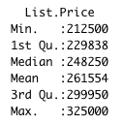
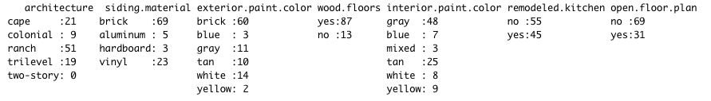
Data gathering and Wrangling
Process:
Collected all 385 home sales in Area 22 since 5/2/18
Random Sampled 125
Went into each record and identified the non-MLS provided data
Some did not have pictures, so were skipped
Ended with 101 data points

Slide 6
Removal of a single Leverage point
Point 84 (corresponding to 9709 Wildbriar LN) was the only of it’s architecture type (2-story). It was a ranch with a second story addition. It was removed from our data as the studentized residuals were calculated as NaN, and it was identified as a leverage point. Due to this, it made sense to remove from the data set. Our final data set had 100 observations.
The following diagnostic plots and model coefficients are created after this leverage points was removed.
Others were left in – one house was a wreck in a nice area, and there’s no reason to remove from data set.

Slide 7
Model fit
The model selected using the best subsets method is:
lm(sales.price ~ List.Price + tax.assessed.value + remodeled.kitchen + BA, data=housing)
AIC = 2114.789

Slide 8
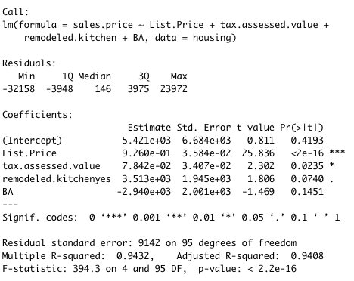
Model fit

Slide 9
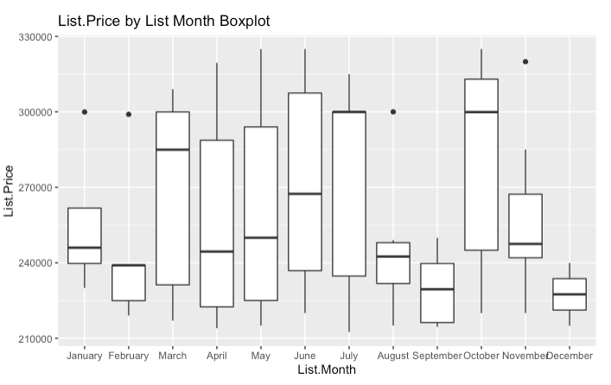
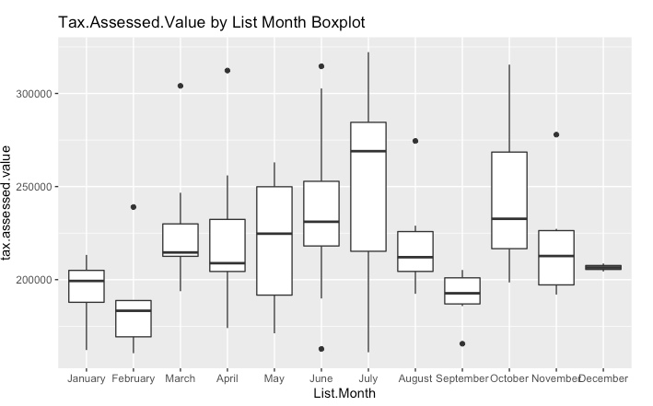
Exploratory Data Analysis

Slide 10
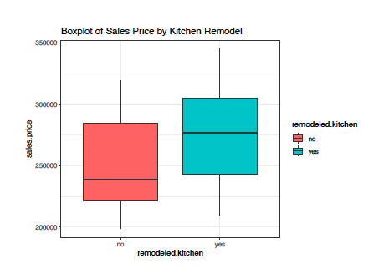
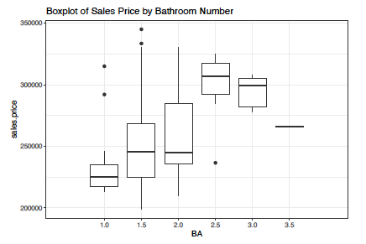
Exploratory Data Analysis

Slide 11
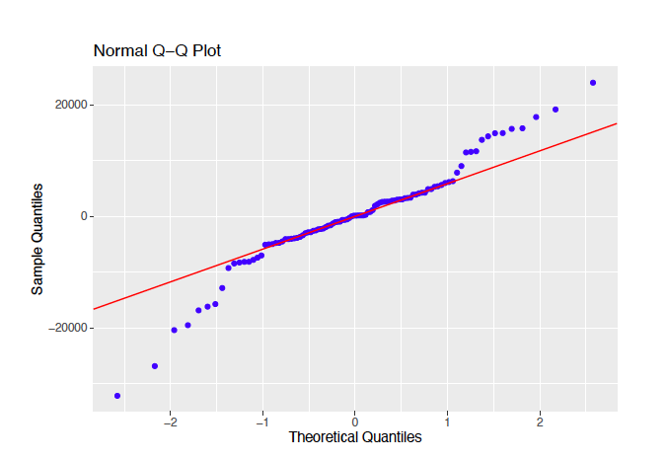
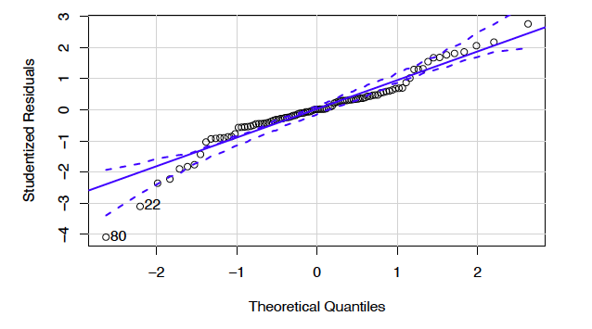
Diagnostics: Normal residuals
Our residuals show some deviation from the normality assumption at the tails of our data. I will share my transformation method in the Transformations section.

Slide 12
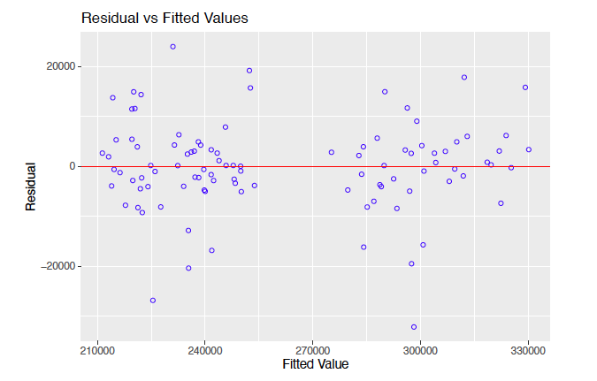
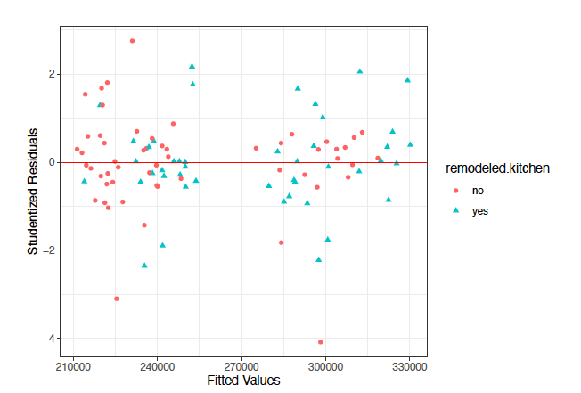
Diagnostics: Constant variance
A cloud of data points for our residuals vs. fitted values shows that we do have constant variance. Studres shows a cloud of data by kitchen.remodel.

Slide 13
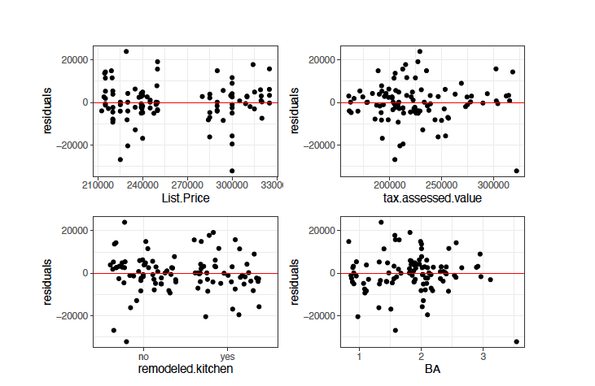
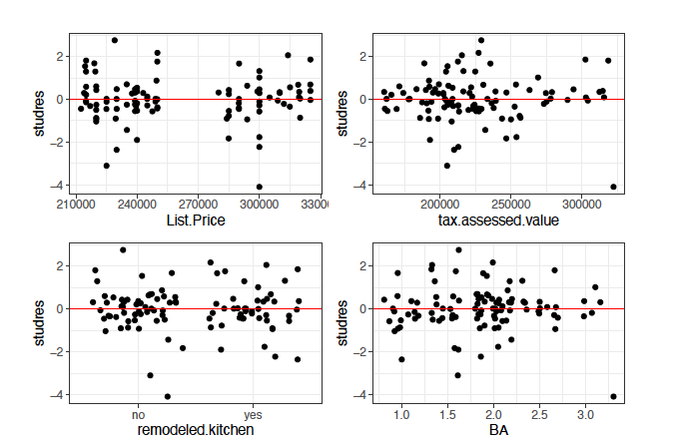
Diagnostics: Residuals vs. regressors
Both regular and studentized residuals show some concerning funneling for tax.assessed.value which could be due to low observation count. I will share my transformation process on Slide 12.

Slide 14
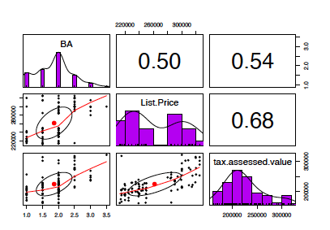

multicollinearity
With VIF values below 10, and our correlation coefficients <.9 or >-.9, we do not have evidence of multicollinearity.

Slide 15
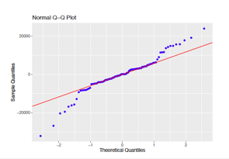
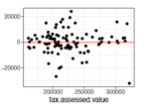
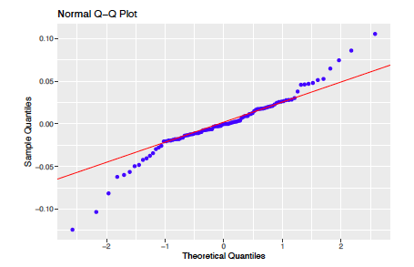
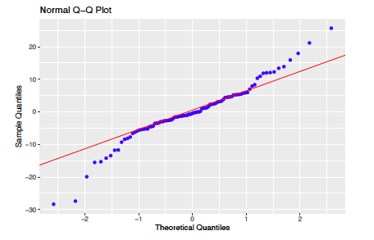
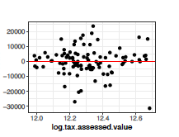
Transformations attempted
Log Sales.Price for Normality
Sqrt Sales.Price for Normality
Log.assessed.value for funneling

Slide 16
Transformations attempted
Due to the need to keep the results easily interpretable by my wife and mother-in-law, and the negligible benefit to our diagnostic plots the three proposed transformations would have, I decided not to transform my data.

Slide 17
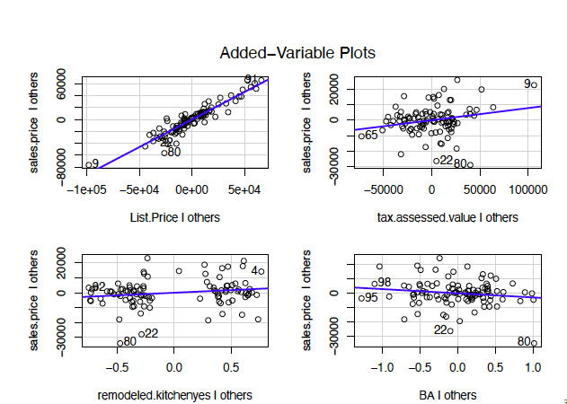
Added variable plots
Add variable plots show no higher order term is needed.

Slide 18
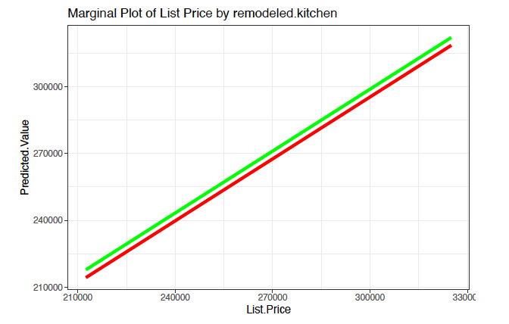
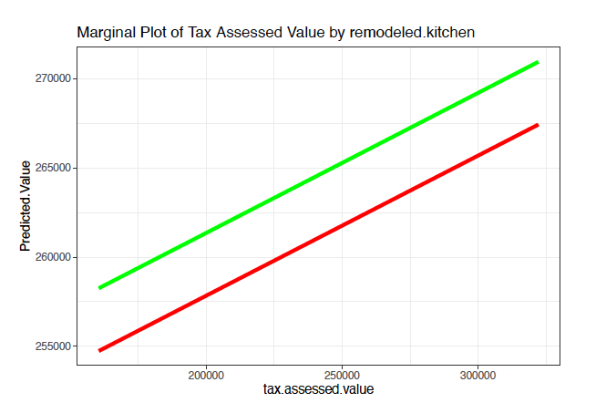
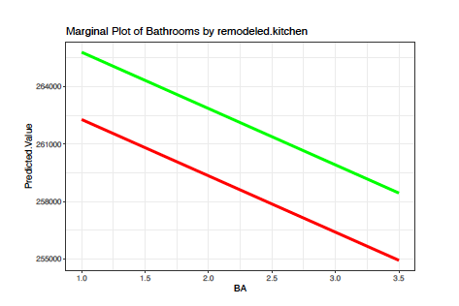
Marginal plots
Marginal plots show the effect of predicting how changing a single variable, holding all other variables at their average, affects the outcome.
Green = remodeled kitchen, red = not remodeled kitchen

Slide 19

interpretation
Significant p-value of <2.2 e-16
Adjusted R2 of .941, meaning 94.1% of the variance in sales price is due to our model.
No evidence of multicollinearity
One removed leverage point, due it is producing NaN fitted value (only two-story home in data)
Overall this model is robust and a good predictor of future data points.

Slide 20
interpretation
On average, all else equal, a one dollar increase in List Price increases the Sales price by .926
On average, all else equal, a one dollar increase in tax.assessed.value increases sales price by .78
On average, all else equal, a remodeled kitchen yields an added 3513 dollars to the sales price compared to a non-remodeled kitchen.
On average, all else equal, an increase in 1 full bath leads to a decrease in Sales price by 2940.10

Slide 21
My Thoughts On the Model
It makes sense that list price and tax assessed value would both have positive coefficients. It was surprising that there was no collinearity between the two.
Bathroom Number having a negative coefficient was surprising, but in this price point, the smaller houses in older areas tend to have higher sales prices than larger houses in new areas.
Bathrooms could be considered a factor in the future to see how results may change. I considered it a continuous variable as it could theoretically continue past the bounds of the max number of bathrooms in our data. Also, it was consistent with bedrooms and number of rooms.

Slide 22
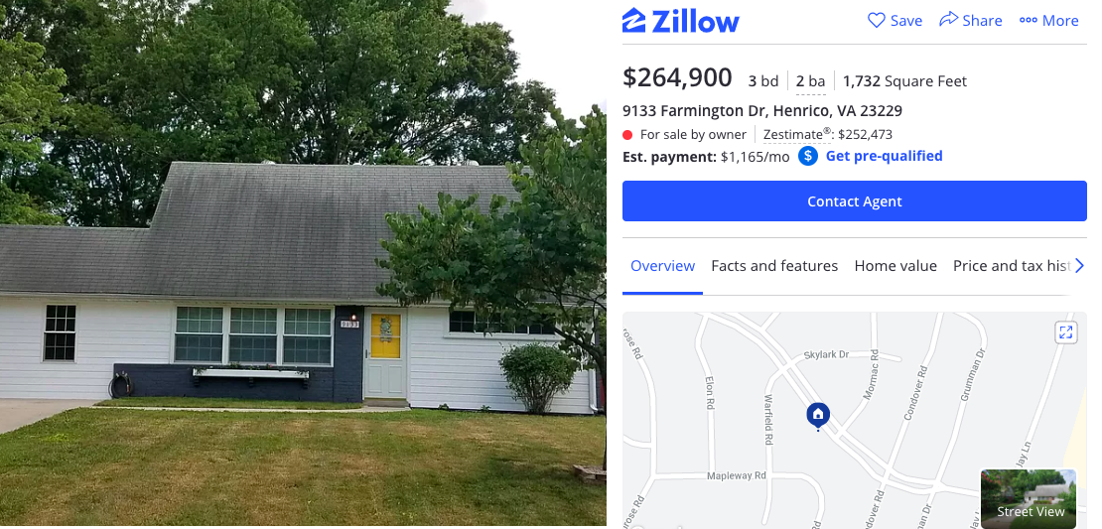
New Prediction: In Range

Slide 23
New Prediction: In Range
> DataNew=data.frame("(Intercept)"=1,
+ "List.Price"= 264900,
+ "tax.assessed.value"= 202400,
+ "remodeled.kitchen"="no",
+ "BA"=2)
> predict(housing_fit_best_outlier, DataNew)
1
260715.8

Slide 24
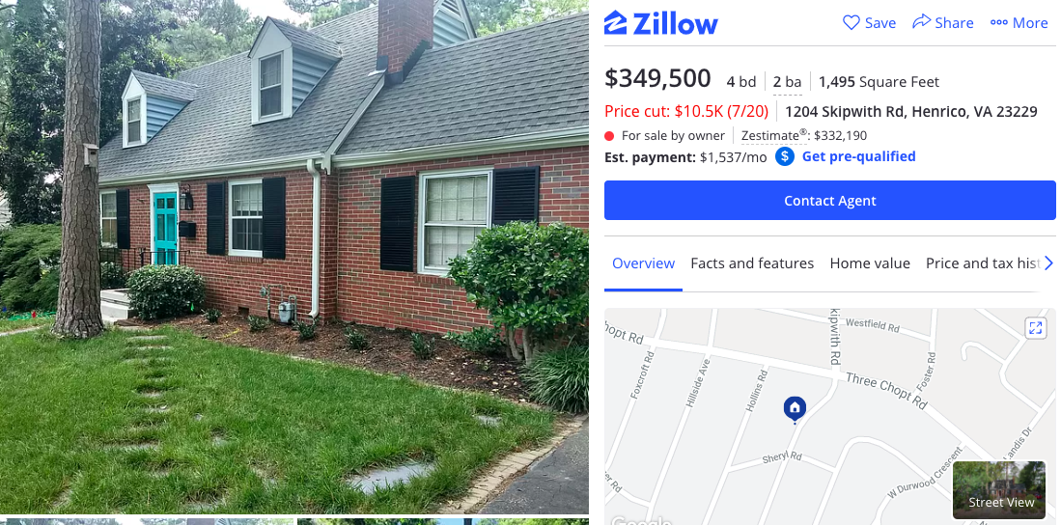
New Prediction: Out of Range

Slide 25
New Prediction: Out of Range
> DataNew=data.frame("(Intercept)"=1,
+ "List.Price"= 349500,
+ "tax.assessed.value"= 260400,
+ "remodeled.kitchen"="no",
+ "BA"=2)
predict(housing_fit_best_outlier, DataNew)
1
343605.4

Slide 26
Next Steps/Recommendations
I recommend this model for use only within the observed values of my data:
Area 22 in Richmond
Under $325,000
Future research could look into other areas/subdivisions/price points
My model in general does not account for significant market changes over time
For Sellers: Go ahead and increase your list price if you’re thinking about 270k
A remodeled kitchen only makes if it costs less than $3500 (not likely)
Your house is worth what it’s worth – little ability to change price other than sinking $$$ into a kitchen

Slide 27
Data Analytics I section

Slide 28
motivation
My wife and I decided to sell our house back in February, with the intent to downsize for my wife to stay at home with our new son. We sold in April.
Coronavirus hit, and the market froze up, so we’ve been living with her parents
Every single day, we spend time on Zillow and Trulia looking at houses, trying to not overpay.
On top of that, her mom is a realtor, so her mom is constantly looking at houses.
I wanted to know how we could identify ”good prices”, and what factors to look for?

Slide 29
Data gathering and Wrangling
Variables of interest provided by MLS:
Bedrooms/Bathrooms/Rooms
Square Footage
Year Built
List Price
List Date
Year Built
Sales Price
Tax Assessed Value

Slide 30
Data gathering and Wrangling
Variables of interest collected manually:
Landscaping 1/3/5
Condition of Roof 1/3/5
Architecture (ranch, colonial, cape cod, trilevel)
Siding material (vinyl, hardboard, brick, aluminum)
Interior/Exterior paint color
Wood Floors (yes/no)
Open Floor plan
Remodeled Kitchen
Walkability Score

Slide 31
Refresh: Model fit

Slide 32
Refresh: Marginal plots
Marginal plots show the effect of predicting how changing a single variable, holding all other variables at their average, affects the outcome.
Green = remodeled kitchen, red = not remodeled kitchen

Slide 33
Assignment summary
Split into training/test (80/20)
4 models were evaluated on predictive ability, using iterated 5 fold cross validation (5 folds per loop, 100 loops)
MSE was metric of choice and shown in following charts
Prediction measured on both training data and validation data, then training and test data
All available predictors were included in the alternative models

Slide 34
Alt Model choices and reason
Multiple Linear Regression: Required in Ana’s class. Predictive ability explored further as a baseline comparison.
Ridge Regression: Shrink the high coefficient of kitchen.remodel (beta = ~3500, compared to <1)
Lasso: Fit a model potentially without the “dominant” List.Price factor
Principal Components: validate whether this would be similar to MLR in this case
Ridge/lasso may be two sides of the same coin

Slide 35
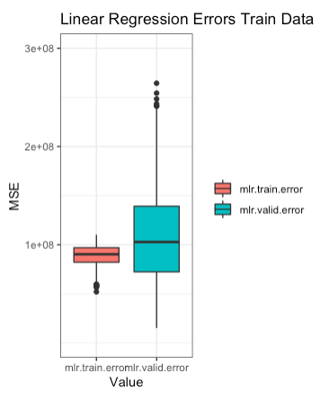
MLR regression error
fit <- lm(formula = sales.price ~ List.Price + tax.assessed.value + remodeled.kitchen + BA, data = train.data)

Slide 36
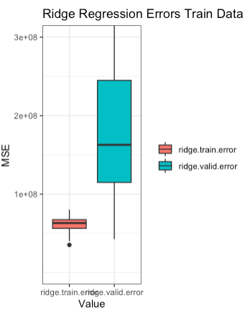
Ridge regression
fit <- glmnet(train.x, train.data$sales.price, alpha=0, lambda=bestlam)

Slide 37
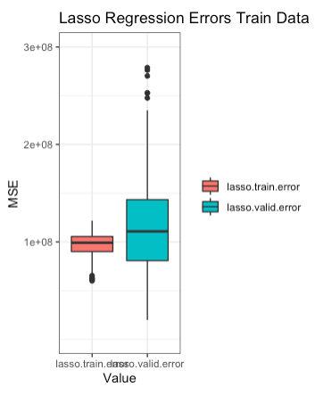
Lasso regression error
fit <- glmnet(train.x, train.data$sales.price, alpha=1, lambda=bestlam.lasso)

Slide 38
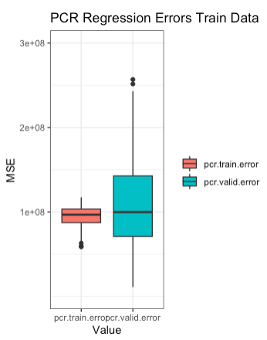
Principal components regression
fit<- pcr(sales.price~., data=train.data)

Slide 39
Side by Side – Train/validation
MLR
Ridge
Lasso
PCR
Overfit!

Slide 40
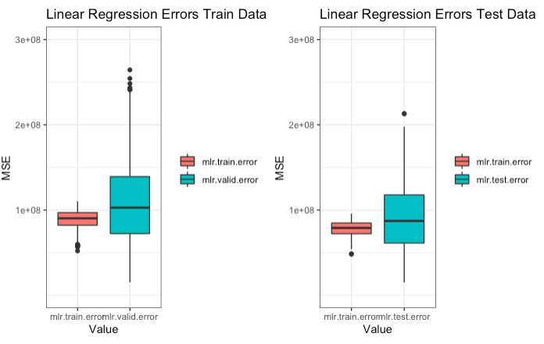
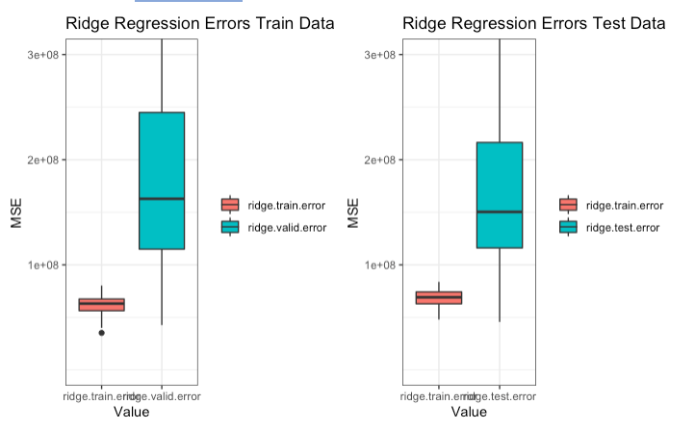
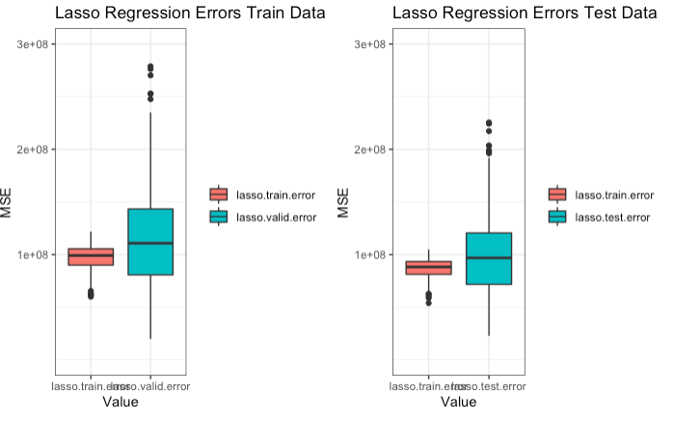
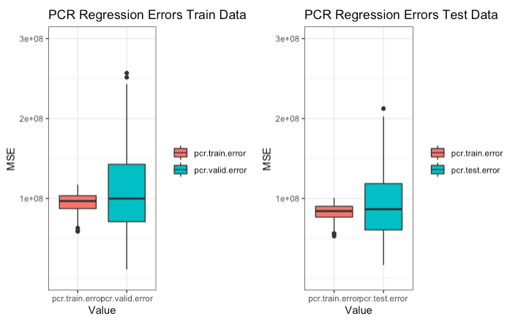
Side by Side – Full grid
Overfit!
MLR
Ridge
Lasso
PCR

Slide 41
Summary
Ridge Regression introduced the idea of overfitting
MLR, Lasso, and PCR were indistinguishable, probably due to the dominance of list.price as a variable in our data set.
For next steps we could remove list price and refit our data science models to see “brute force” modeling of all other variables
Recommendation for Interpretability: MLR
Recommendation for Predictive Ability: MLR, Lasso, PCR

Slide 42
Overall thoughts
This class was more focused on predictive ability as the goal – not significance or assumptions.
“Throw it against the wall and see what sticks”
Ridge and Lasso, though similar, can produce very dissimilar predictive results
In data sets where MLR suggests high significance in modeling and high adjusted R2, MLR may be the gold standard.

